Slide 1

CHAPTER 5: JavaScript Functions and Events handling
CLO3: Create interactive web pages using current standards-compliant client-side web technologies

Slide 2
Introduction
To develop and maintain a large program
construct it from small, simple pieces
divide and conquer
2 categories of functions
Prepackaged functions and objects available in JavaScript
JavaScript provides several objects that have a rich collection of methods for performing common mathematical calculations, string manipulations, date and time manipulations, and manipulations of collections of data called arrays
Example: Math.pow()
Programmer-defined Functions
Perform specific tasks and use them at many points in a script

Slide 3
Introduction
JavaScript events
Allow scripts to respond to user interactions and modify the page accordingly
Events and event handling
Helps make web applications more dynamic and interactive
Examples of HTML events:
When a user clicks the mouse
When a web page has loaded
When an image has been loaded
When the mouse moves over an element
When an input field is changed
When an HTML form is submitted
Event Handler
is a function that responds to an event

Slide 4
Part 1: Functions

Slide 5
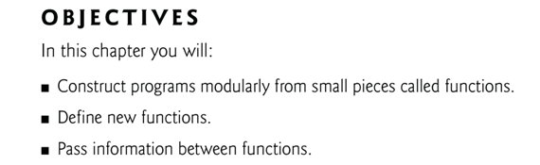
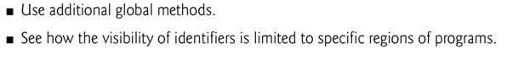

Slide 6
Programmer-defined Functions…
A function is a block of code that will be executed when "someone" calls it.
Methods are called in the same way as functions, but require the name of the object to which the method belongs and a dot preceding the method name
Function (and method) arguments may be constants, variables or expressions

Slide 7
Programmer-defined Functions…
Calling a Function with Arguments: myFunction(argument1,argument2)
When you call a function, you can pass along some values to it, these values are called arguments or parameters.
You can send as many arguments as you like, separated by commas (,)
Declare the argument, as variables, when you declare the function:
function myFunction(var1,var2) { some code }
The variables and the arguments must be in the expected order. The first variable is given the value of the first passed argument etc.
<button onclick="myFunction('Harry Potter','Wizard')">Try it</button> <script> function myFunction(name,job) { alert("Welcome " + name + ", the " + job); } </script>

Slide 8
Programmer-defined Functions…
Function can return a value back to where the call was made by using the return statement.
When using the return statement, the function will stop executing, and return the specified value.
Syntax
function myFunction() { var x=5; return x; }
The function-call will be replaced with the return value:
var myVar = myFunction();
The variable myVar holds the value 5, which is what the function "myFunction()" returns

Slide 9
Programmer-defined Functions…
You can also use the return value without storing it as a variable:
document.getElementById("demo").innerHTML = myFunction();
document.getElementById("id").innerHTML is a document object method that access/manipulate element with the specified id.
Example: Calculate the product of two numbers, and return the result:
function myFunction(a,b) { return a*b; } document.getElementById(“EltId").innerHTML=myFunction(4,3);

Slide 10
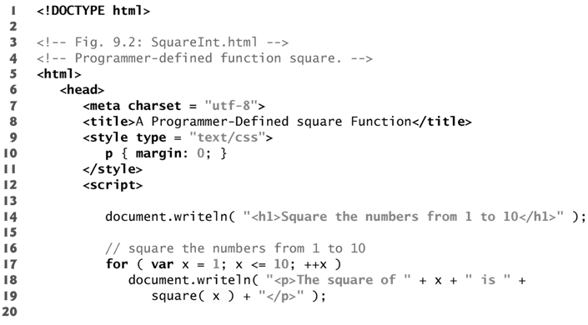
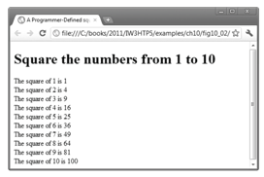
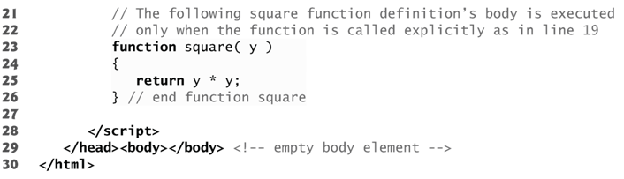
Example1 square

Slide 11
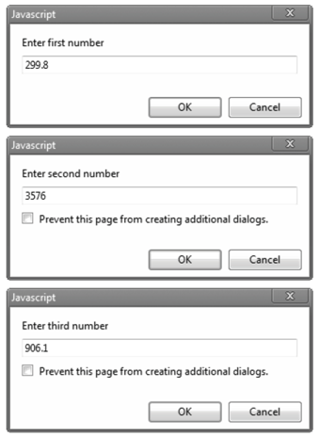
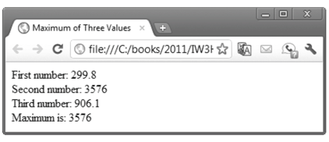
Example 2…
Problem Statement
Write a JavaScript that determines and returns the largest of three floating-point values

Slide 12
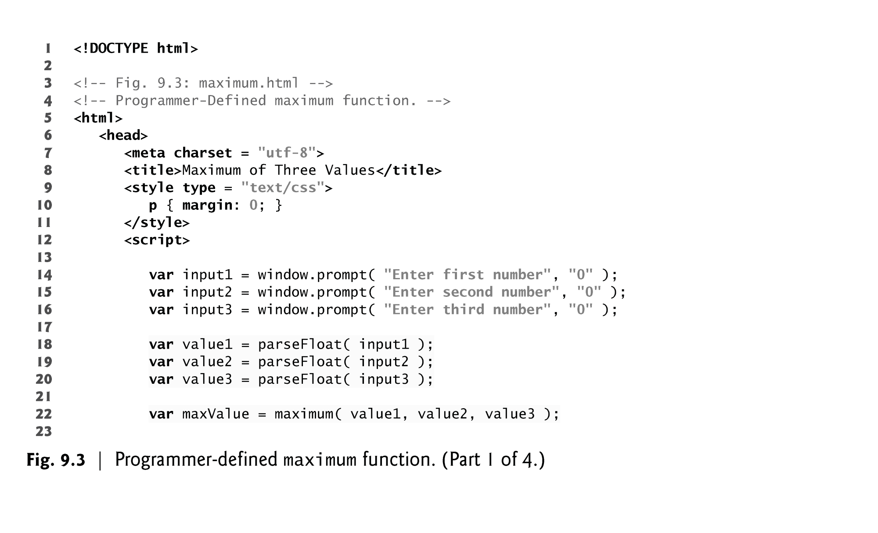
Example 2…

Slide 13
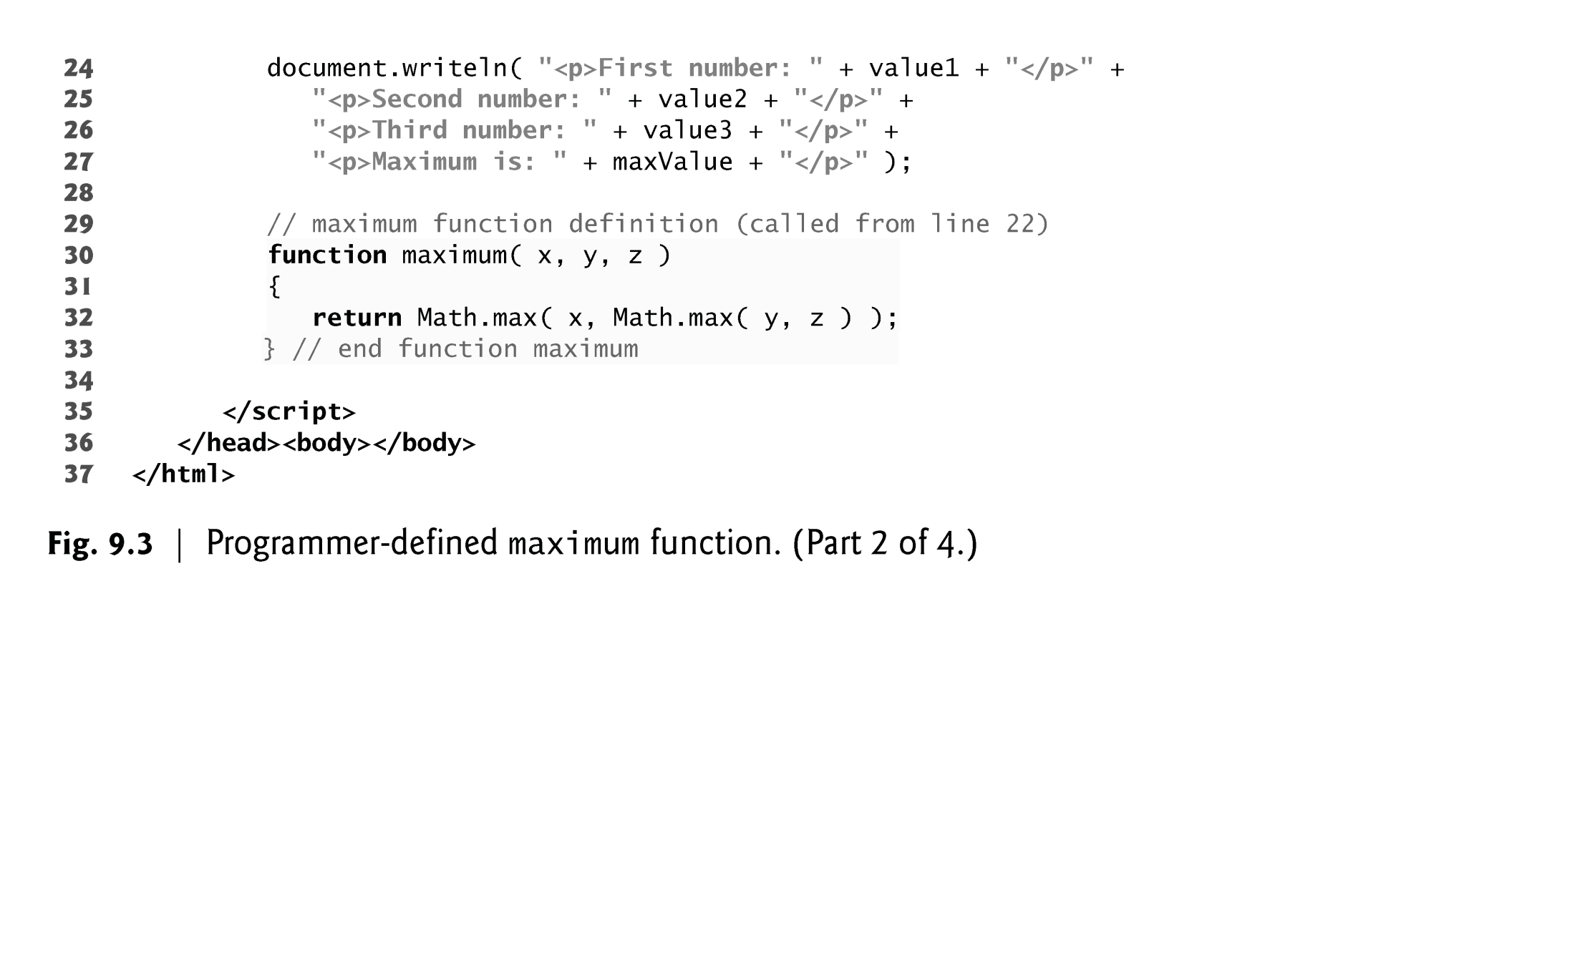
Example 2

Slide 14
Notes on Programmer-Defined Functions
All variables declared with the keyword var in function definitions are local variables—this means that they can be accessed only in the function in which they’re defined.
A function’s parameters are also considered to be local variables
There are several reasons for modularizing a program with functions.
Divide-and-conquer approach makes program development more manageable
Software reusability
Avoid repeating code in a program

Slide 15
Scope Rules
Each identifier in a program has a scope
The scope of an identifier for a variable or function is the portion of the program in which the identifier can be referenced
Global variables or script-level variables are accessible in any part of a script and are said to have global scope
Thus every function in the script can potentially use the variables

Slide 16
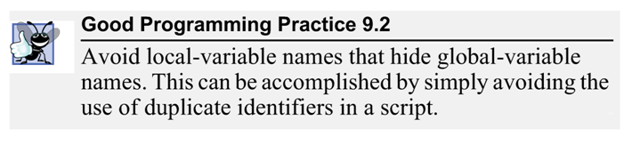
Scope Rules (local variables)…
Identifiers declared inside a function have function (or local) scope and can be used only in that function
Local variables of a function and function parameters have function scope
If a local variable in a function has the same name as a global variable, the global variable is “hidden” from the body of the function.

Slide 17
JavaScript Global Functions
JavaScript provides global functions as part of a Global object
This object contains
all the global variables in the script
all the user-defined functions in the script
all the built-in global functions listed in the following slide
You do not need to use the Global object directly; JavaScript uses it for you

Slide 18
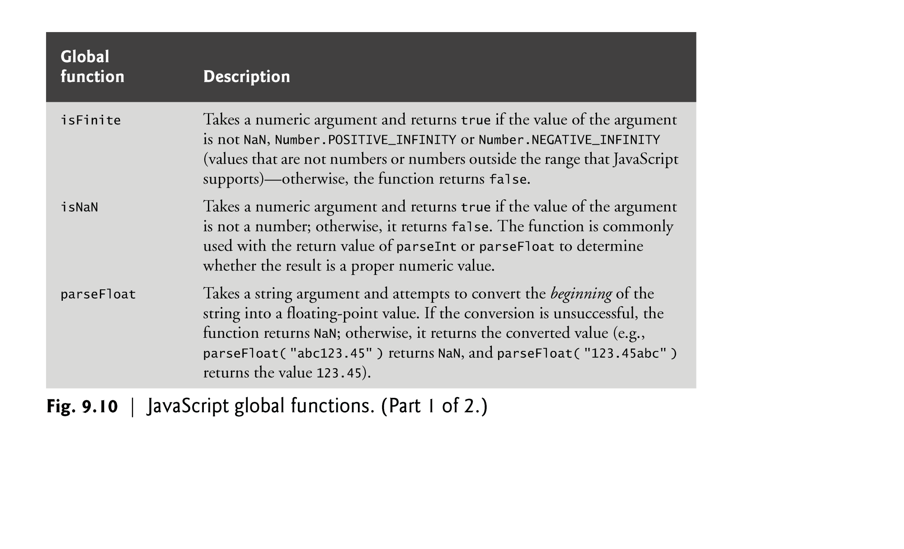
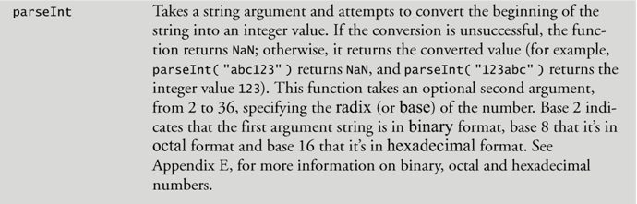

Slide 19
Part 2: Events

Slide 20
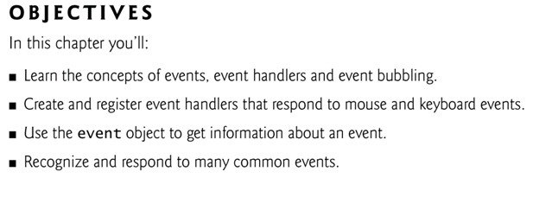

Slide 21
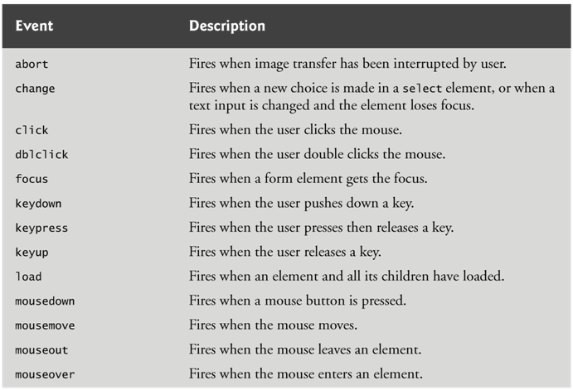
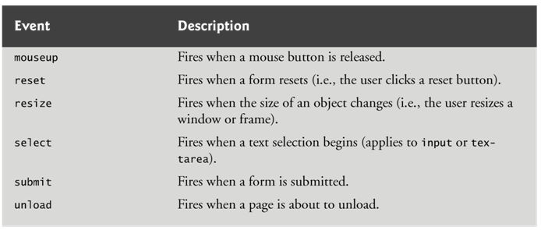
Common Events

Slide 22
load Event…
The window object’s load event fires when the window finishes loading successfully
Two models for registering event handlers
IN HTML
<body onload = "start()">
In JavaScript
document.onload = "start()”;
JavaScript function start is called when the body element loads or document loads

Slide 23
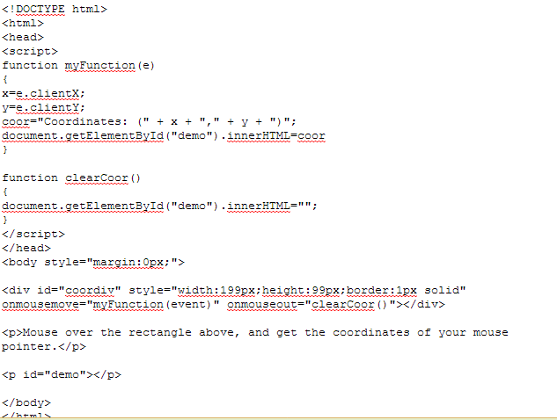
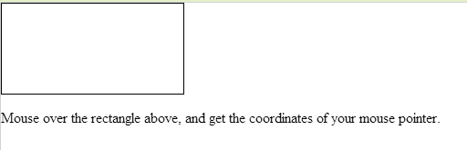
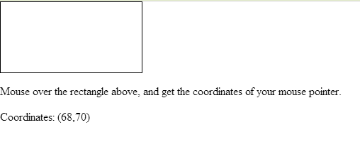
mouseMove & mouseOut Events
mousemove event occurs whenever the user moves the mouse over the web page

Slide 24
Rollovers with mouseover and mouseout
When the mouse cursor enters an element, an mouseover event occurs for that element
When the mouse cursor leaves the element, a mouseout event occurs for that element

Slide 25
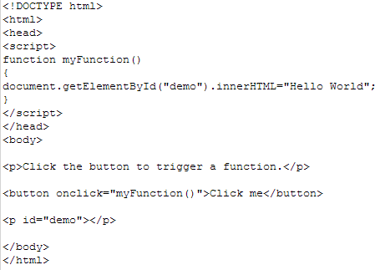
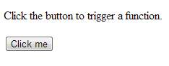
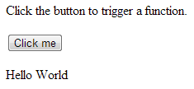
OncliCk Event
The onclick event occurs when the user clicks on an element

Slide 26
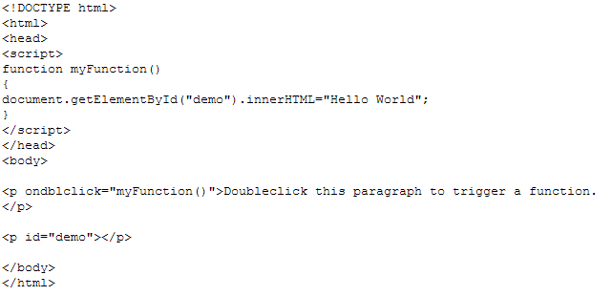
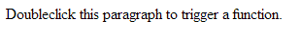
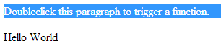
Ondblclik Event
The ondblclick event occurs when the user double clicks on an element

Slide 27
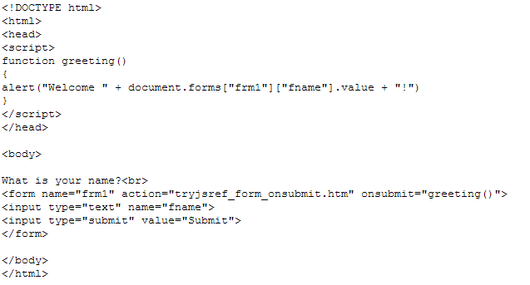
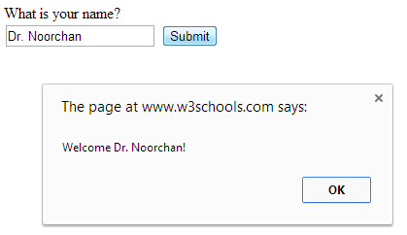
Onsubmit Event
The onsubmit event occurs when the submit button in a form is clicked

Slide 28
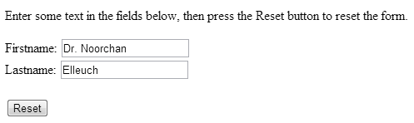
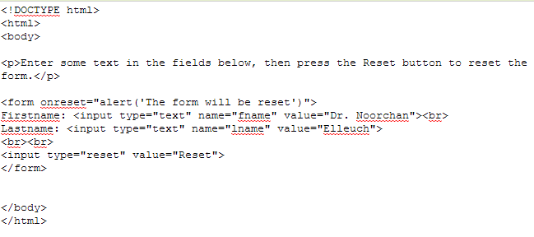
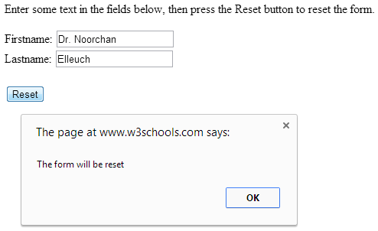
Onreset Event
The onreset event occurs when the reset button in a form is clicked

Slide 29
References
TextBook and Pearson slides
W3school.com

